Slide 1
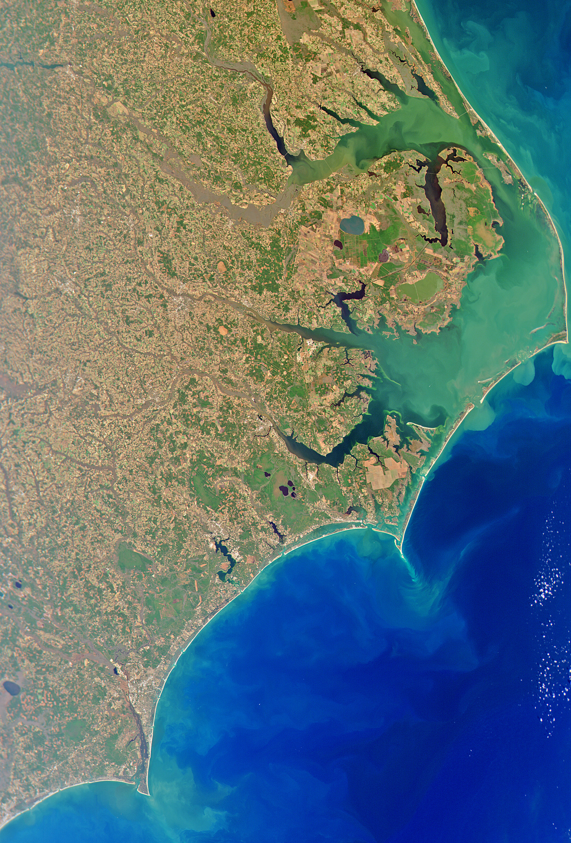
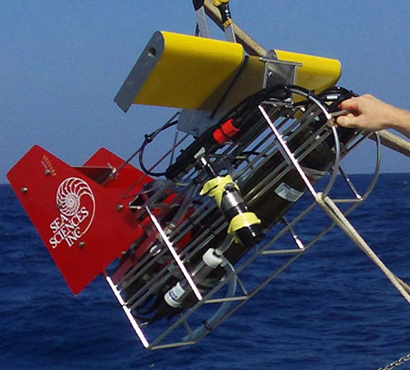
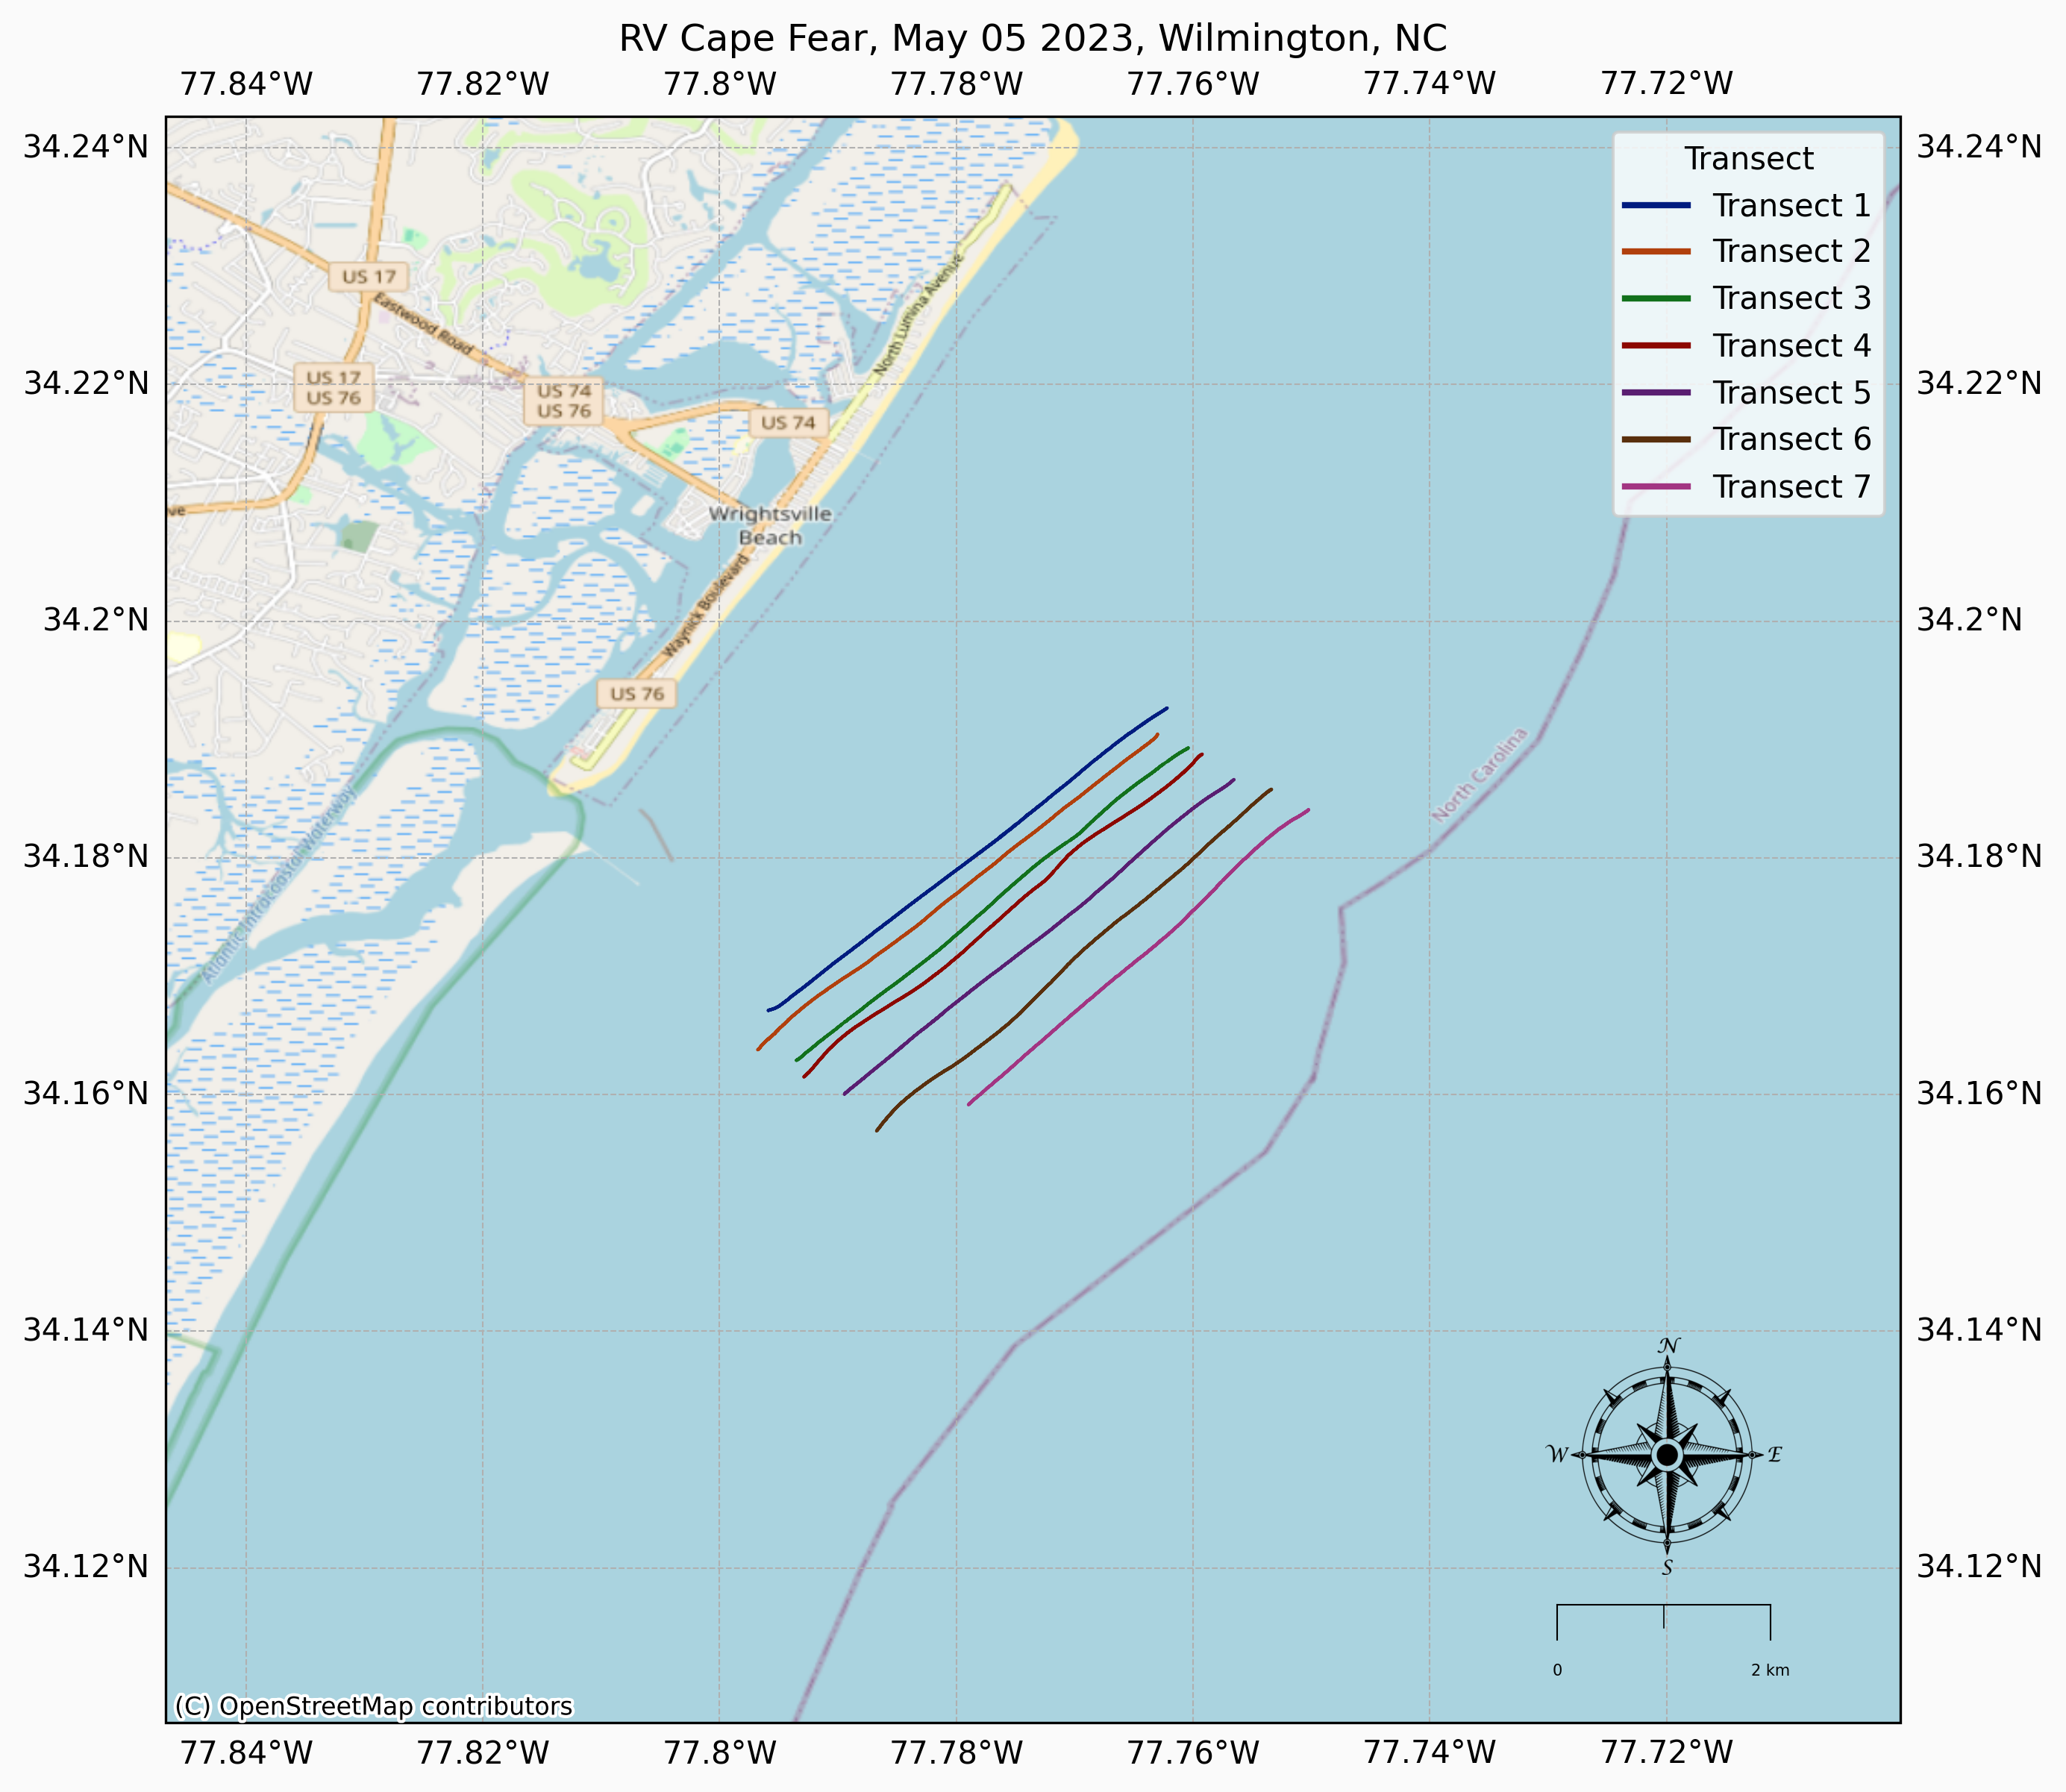
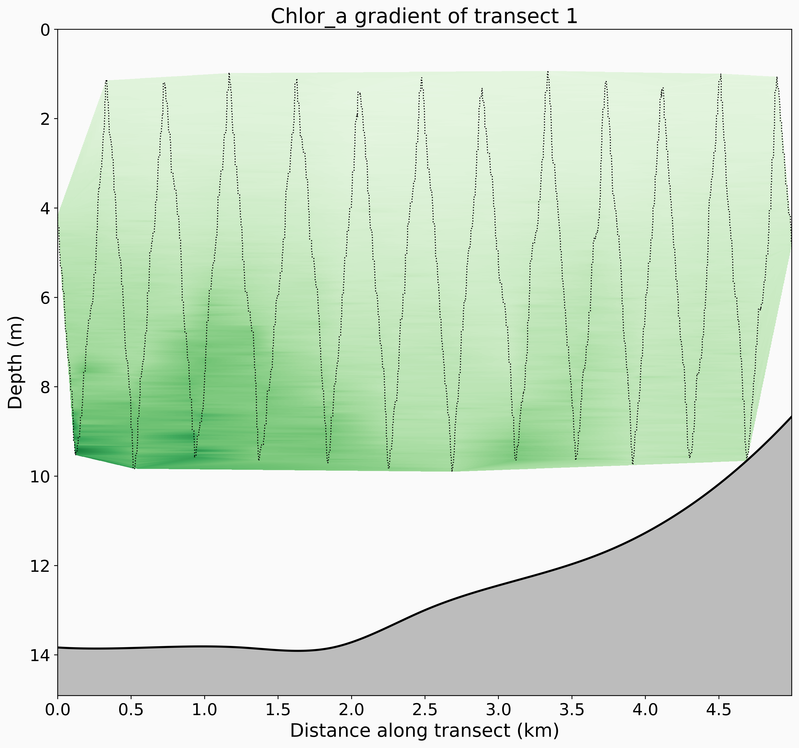
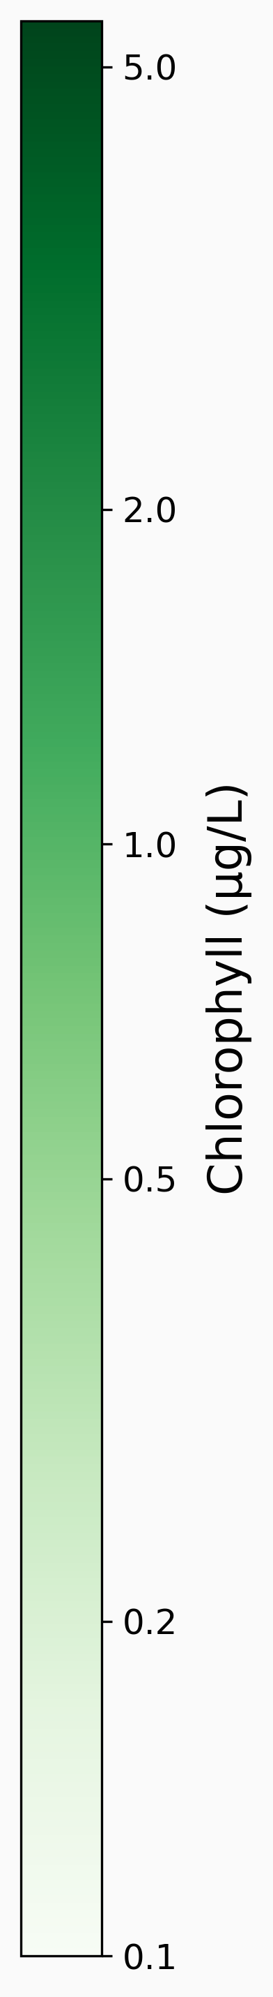
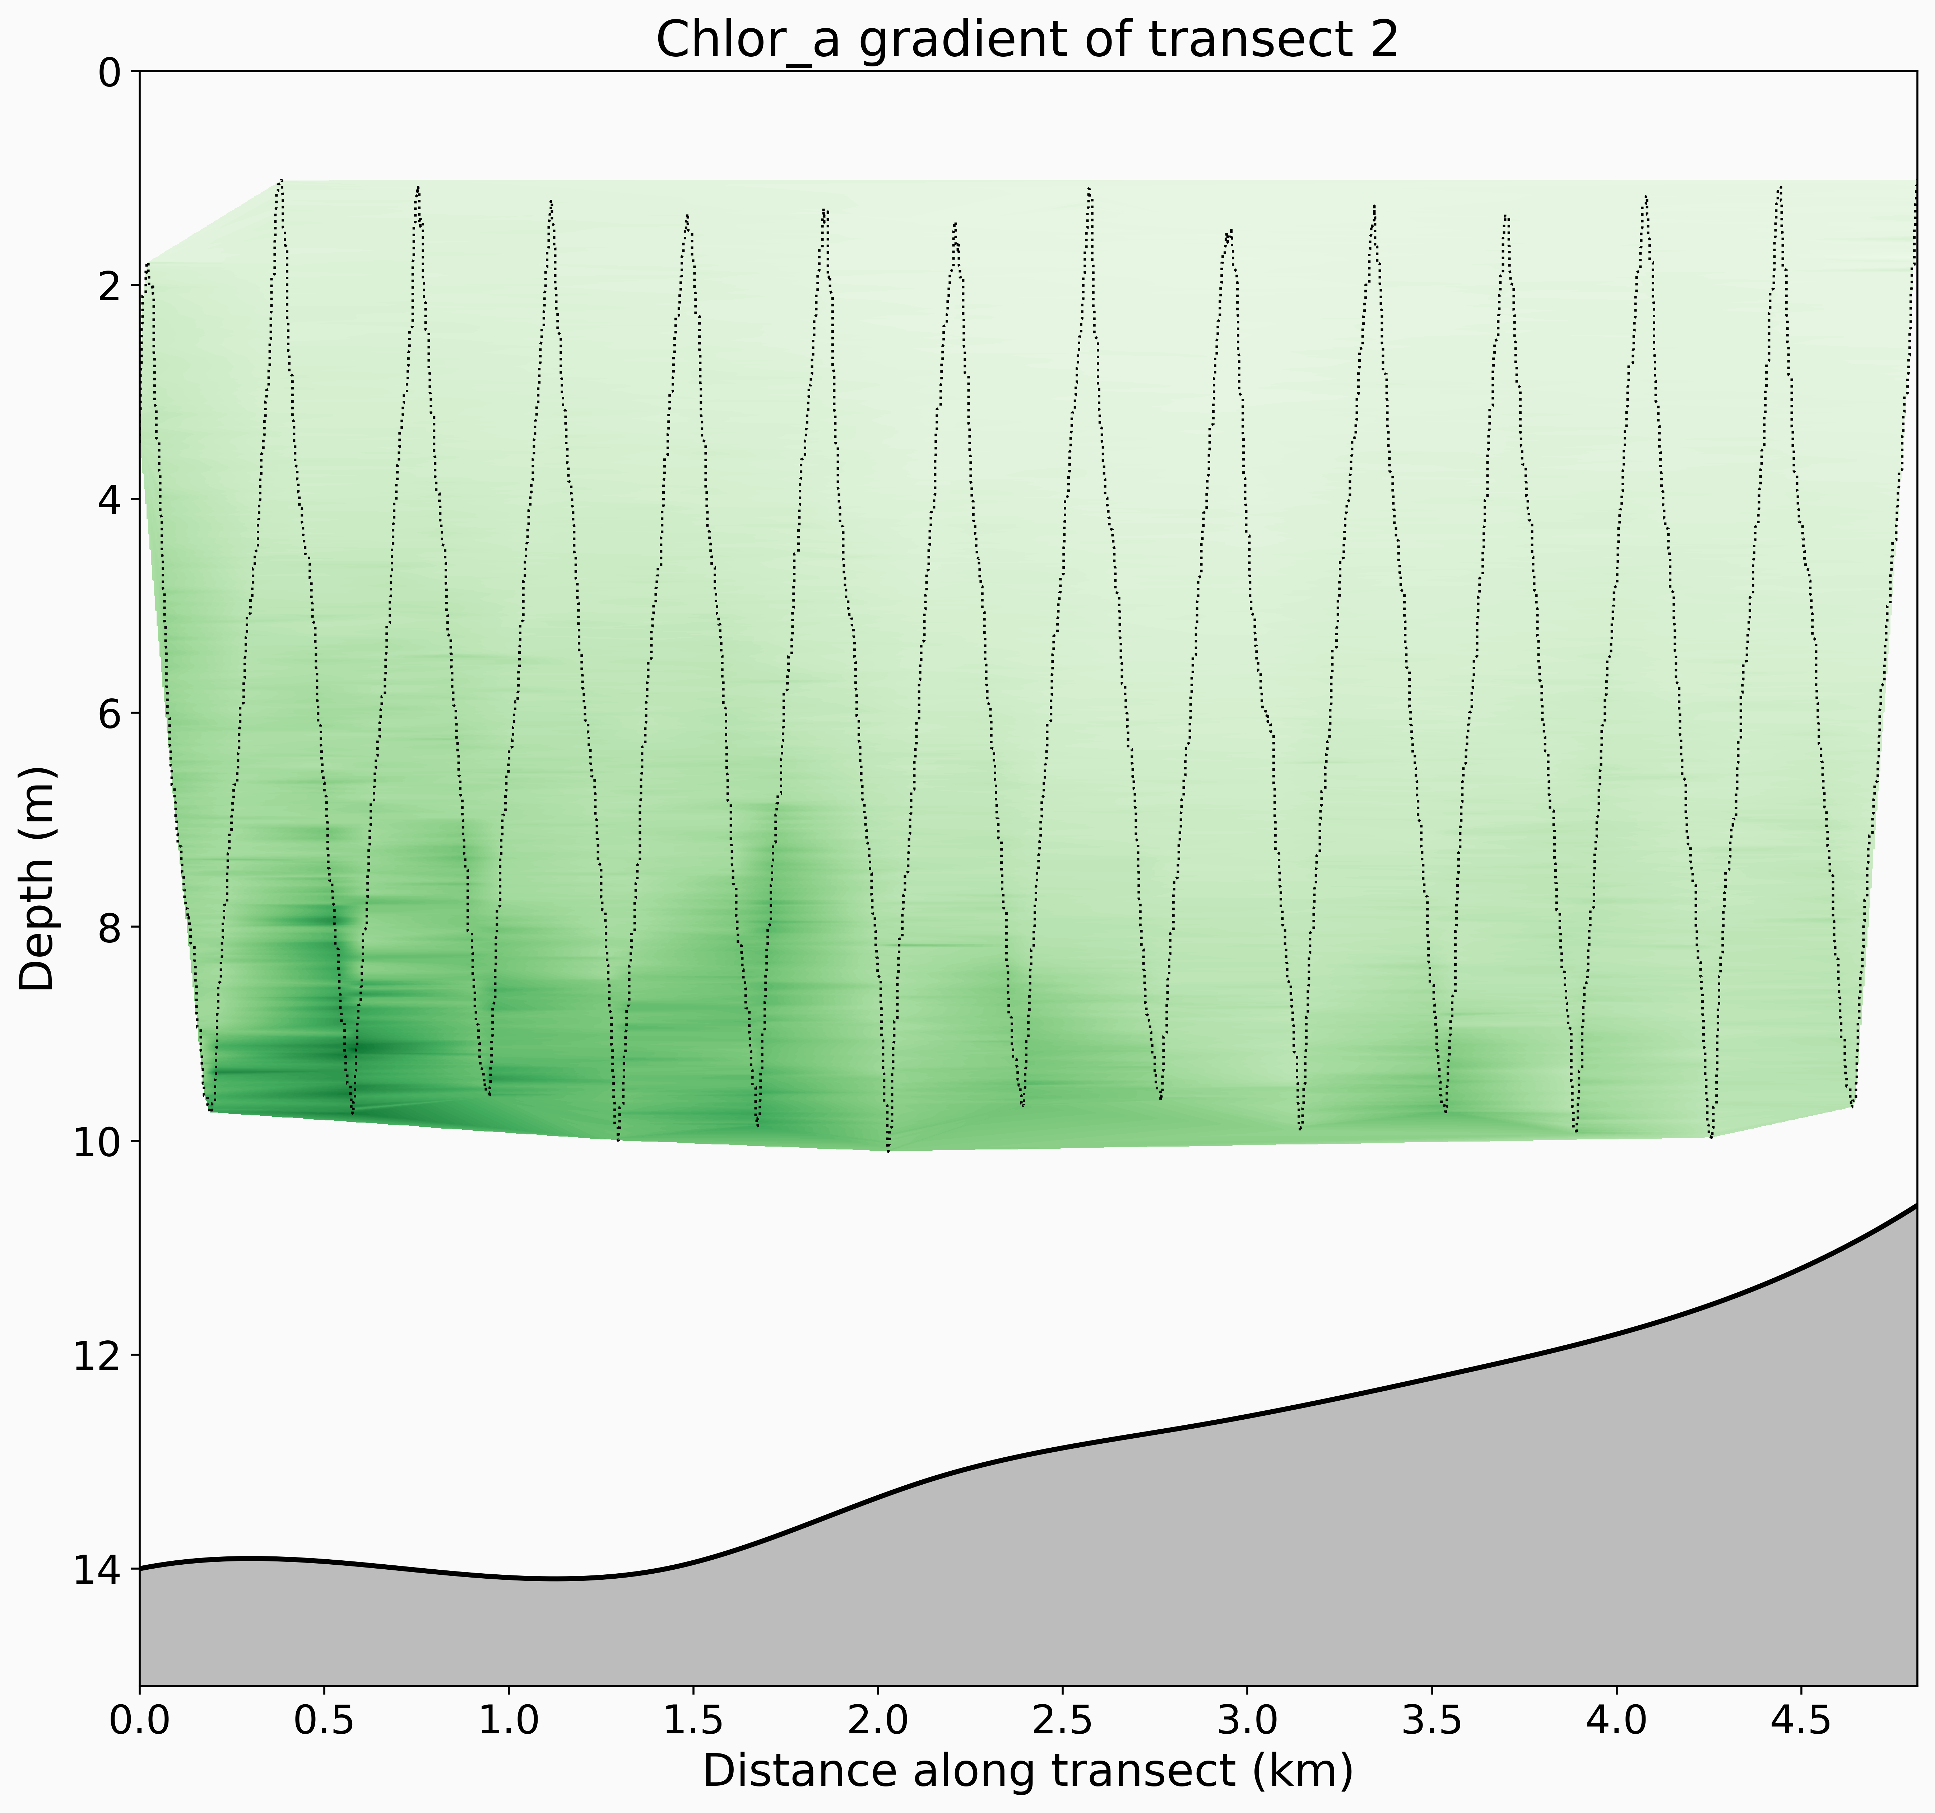
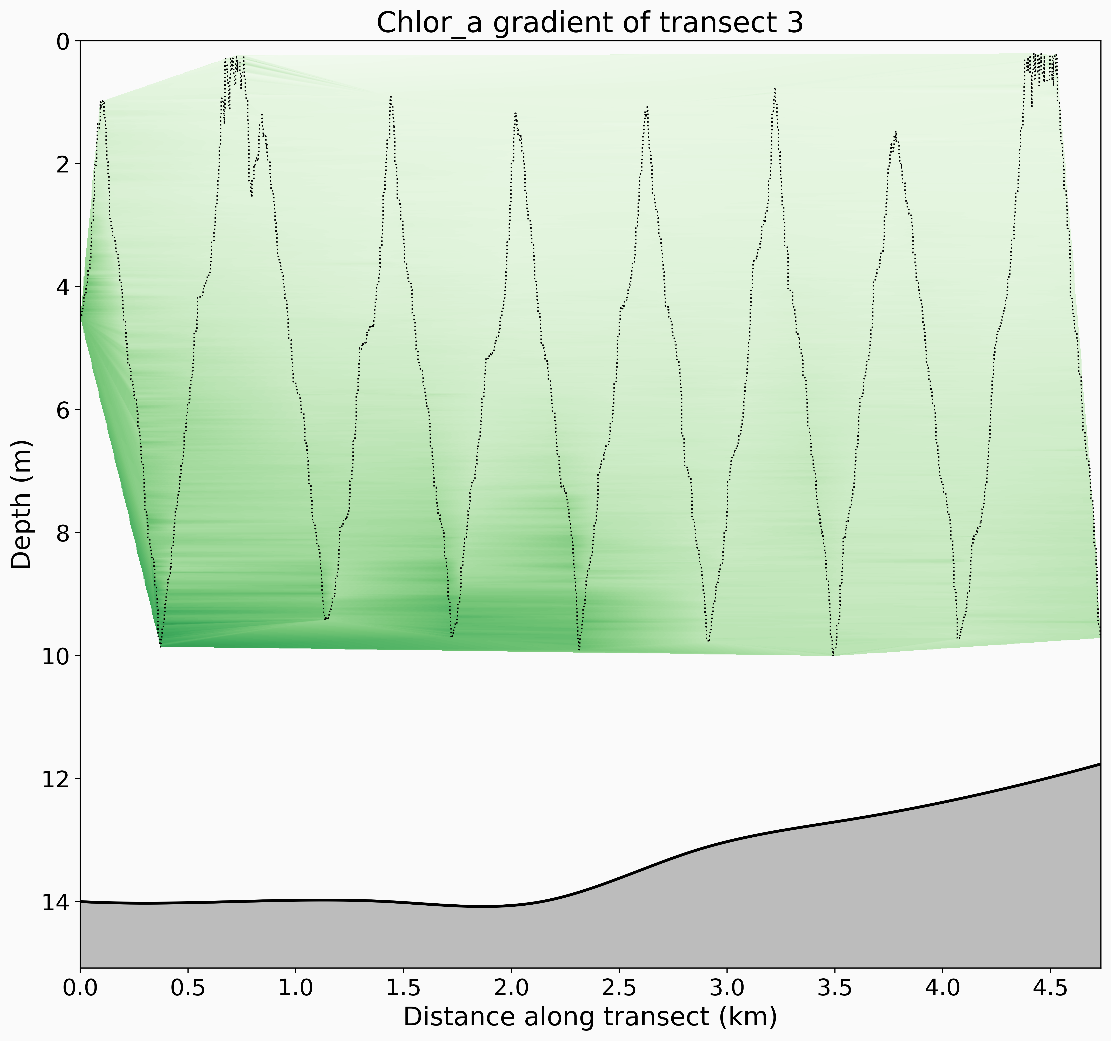
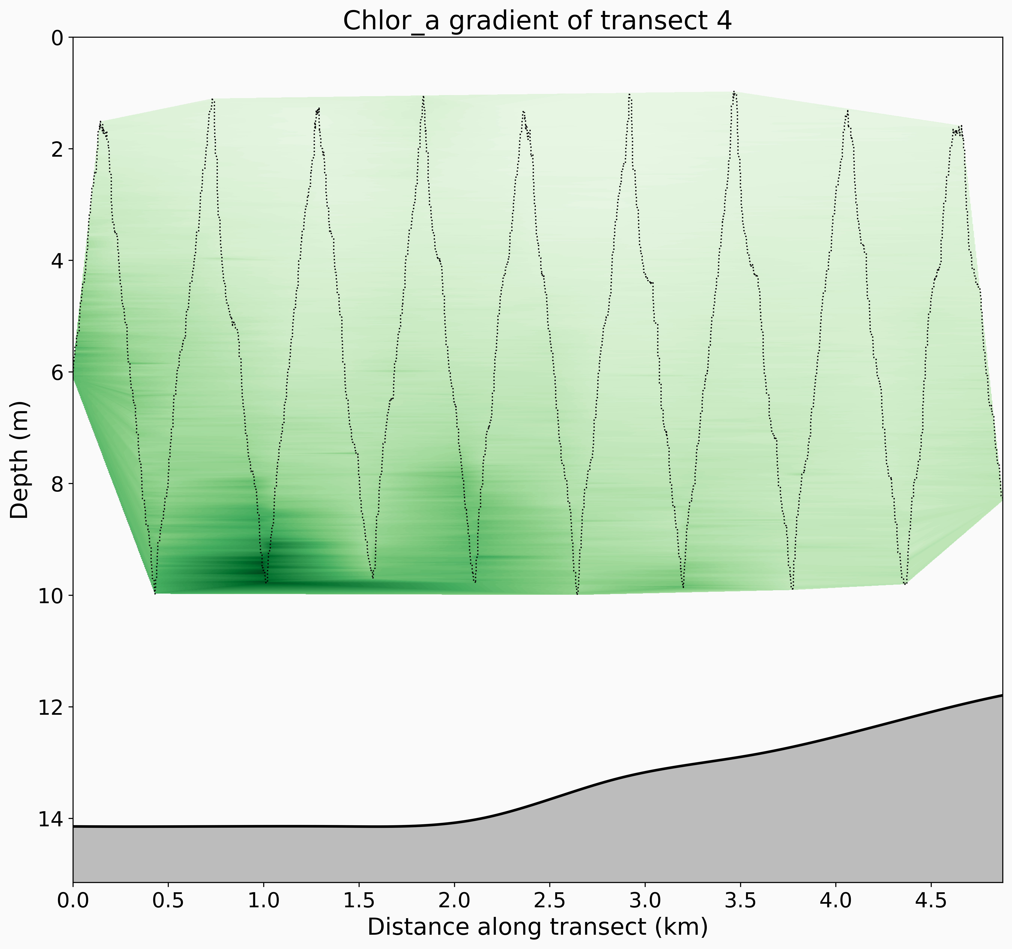
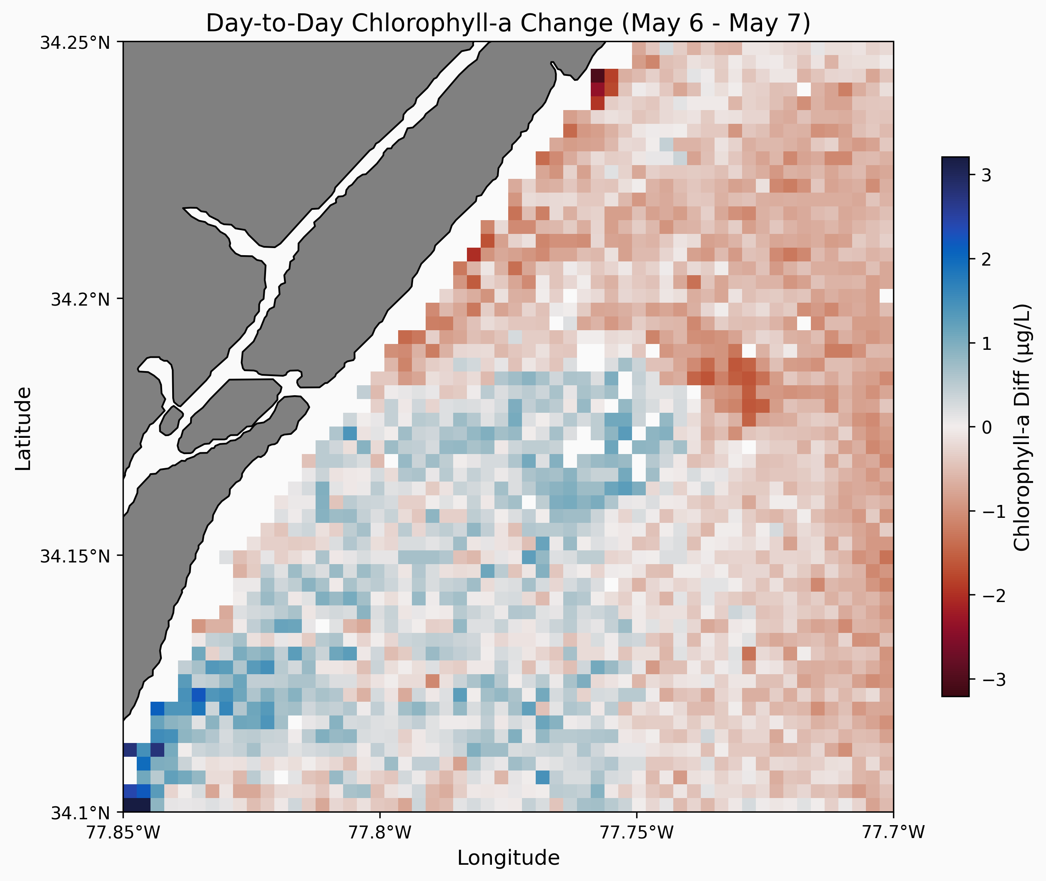
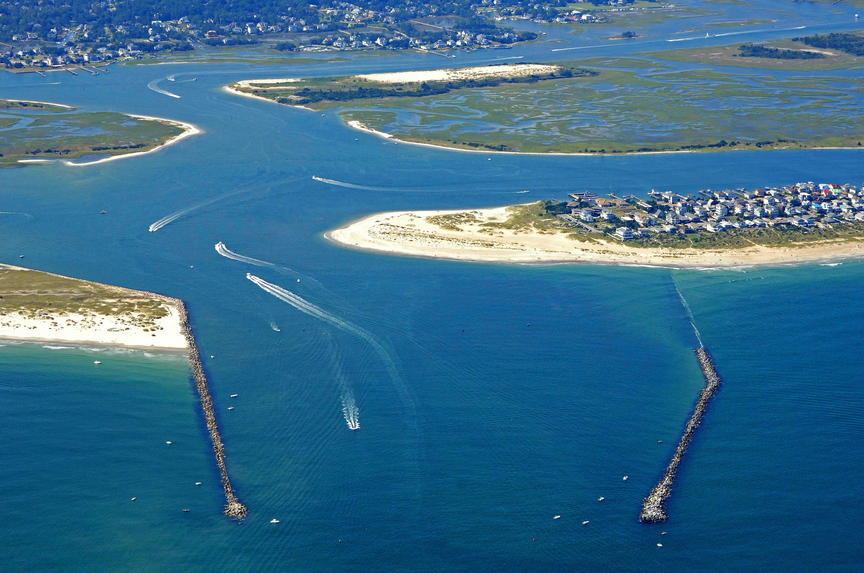
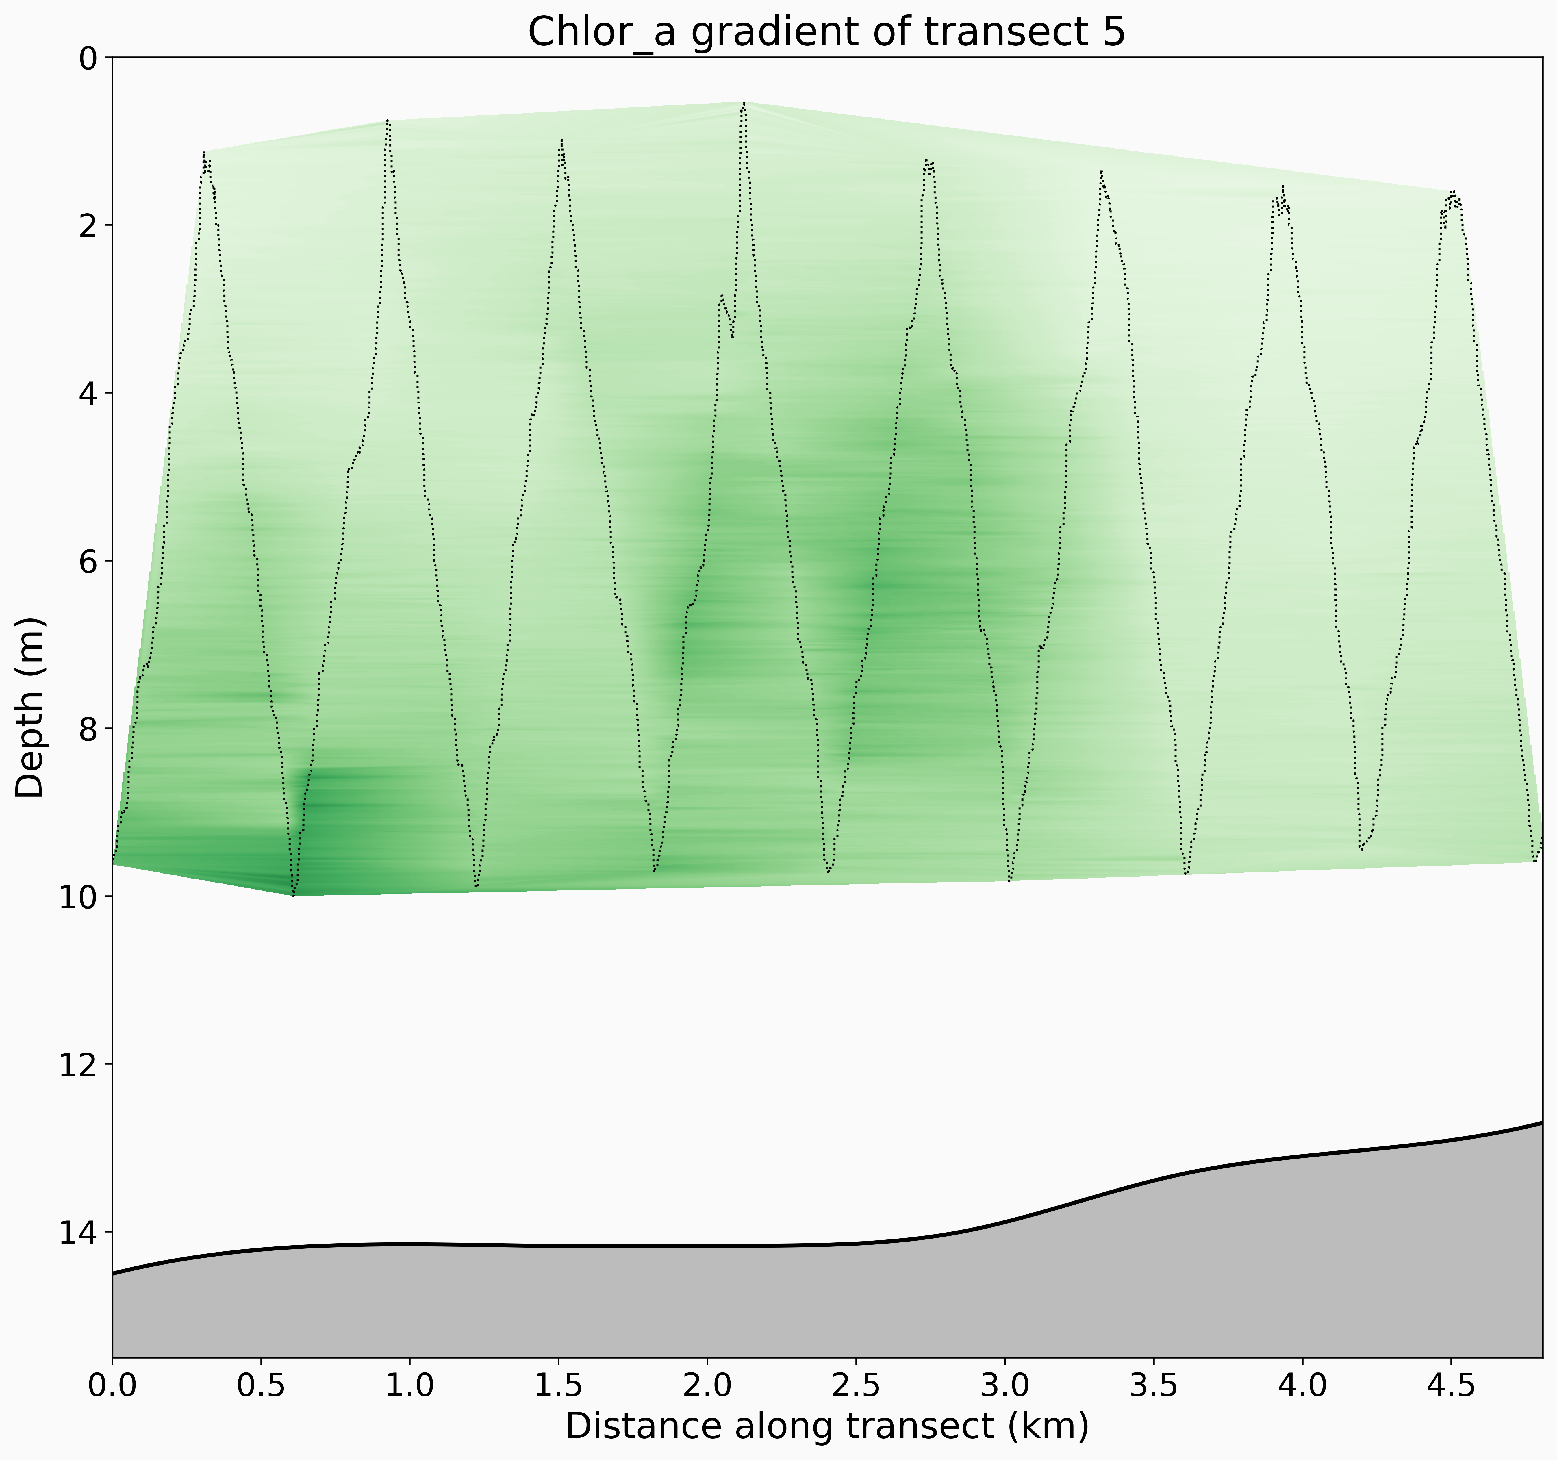
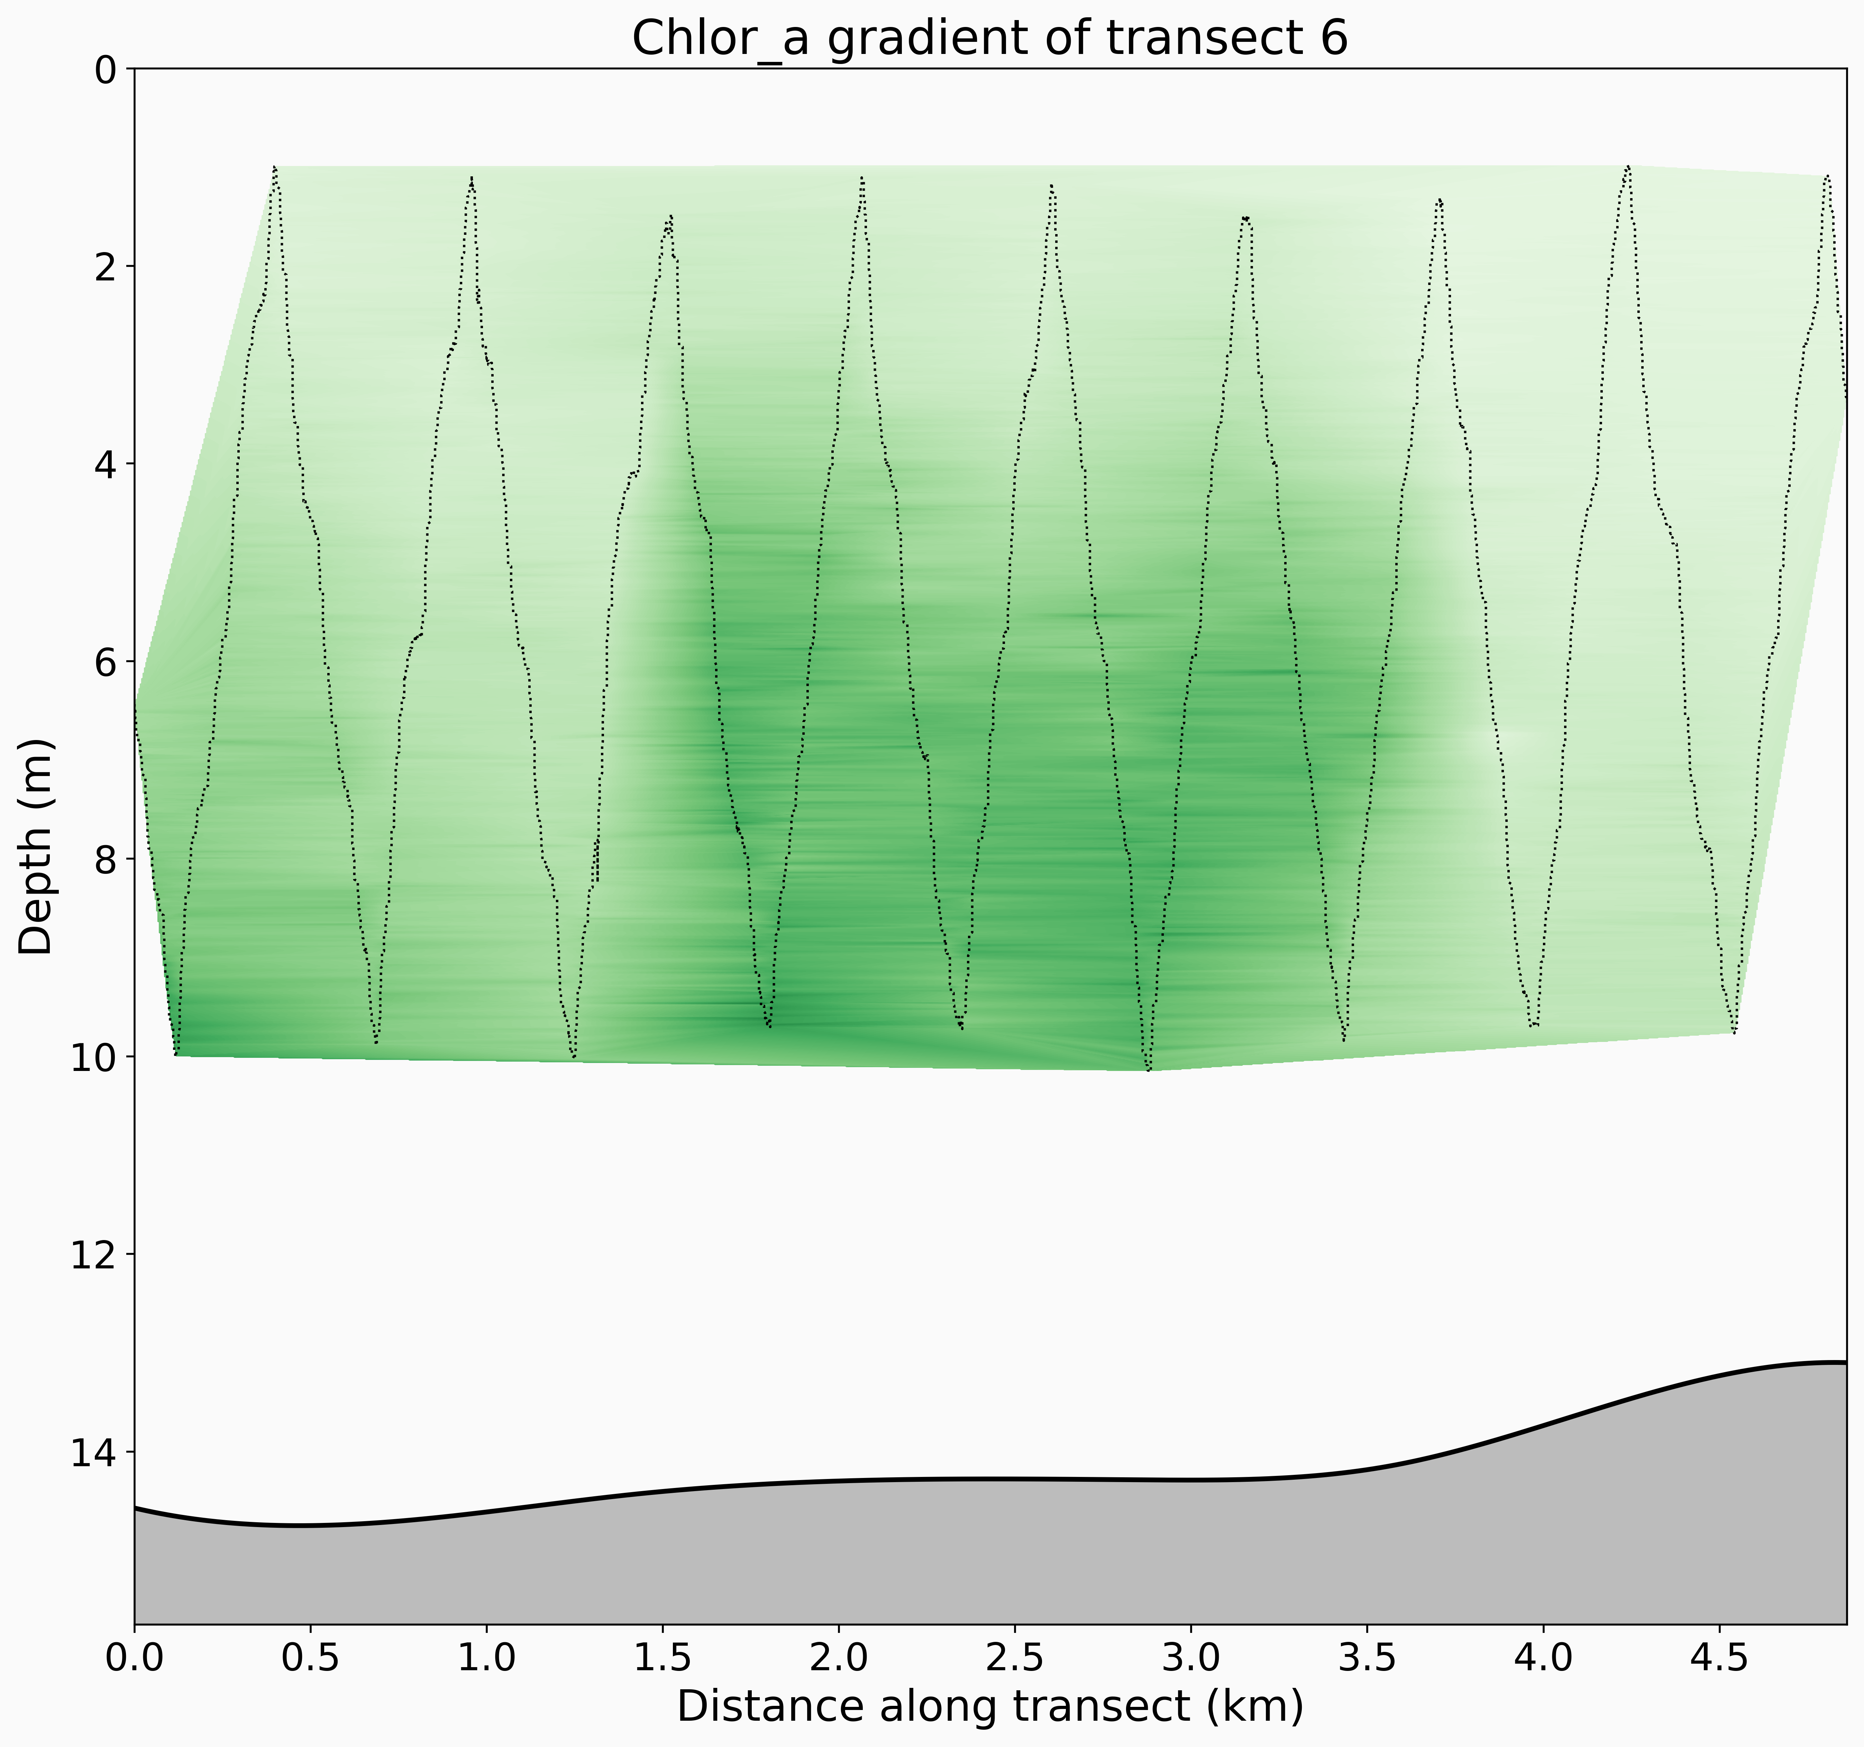
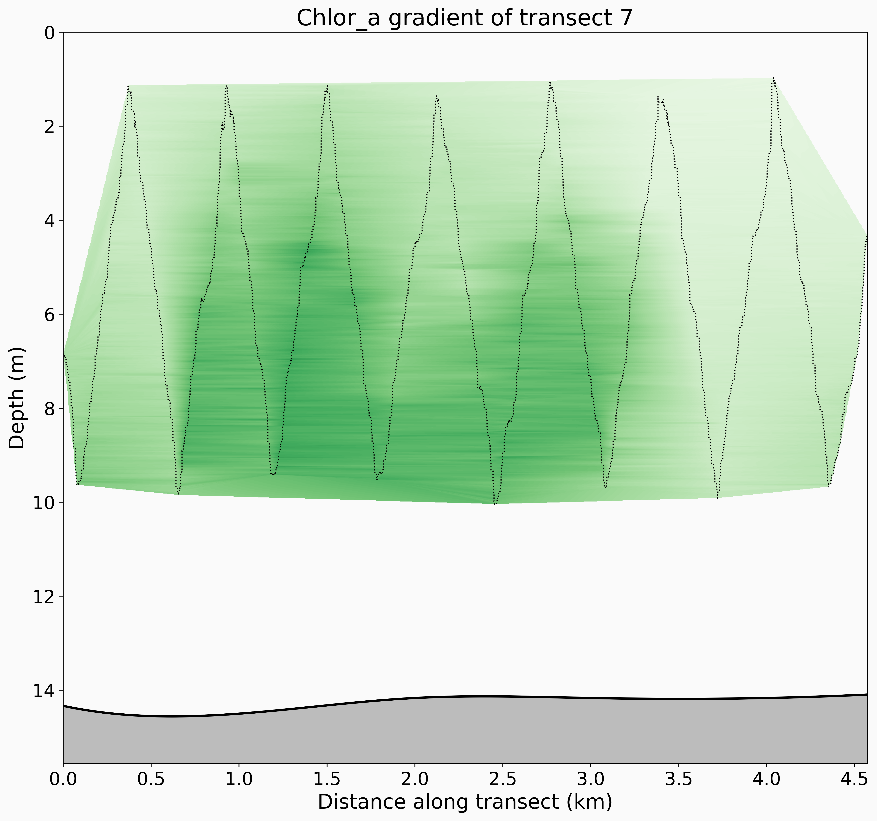
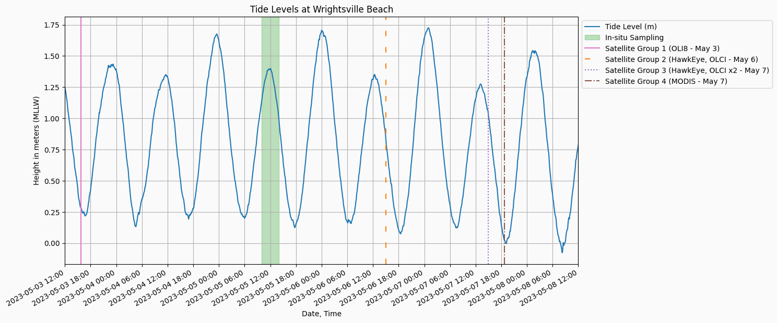
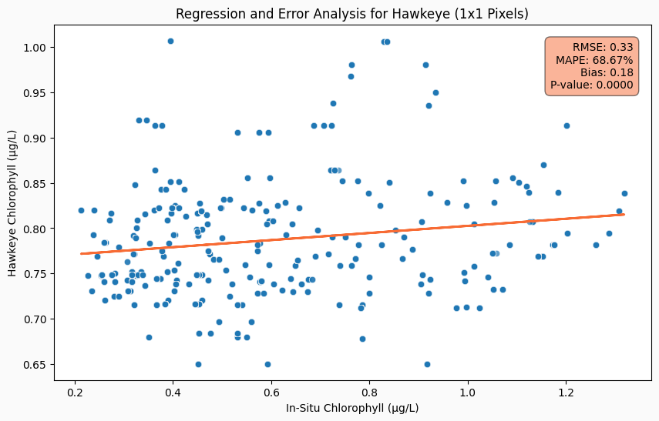
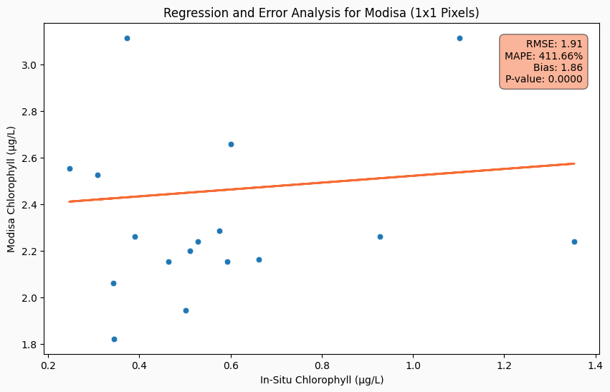
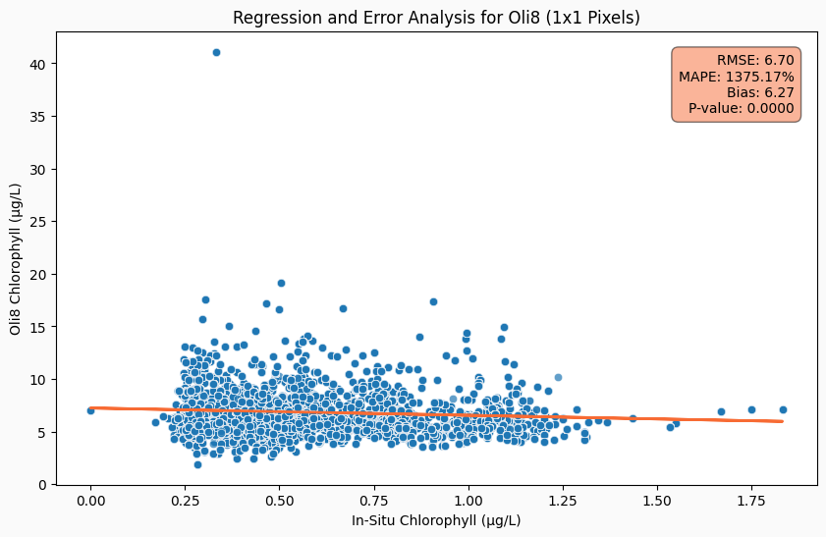
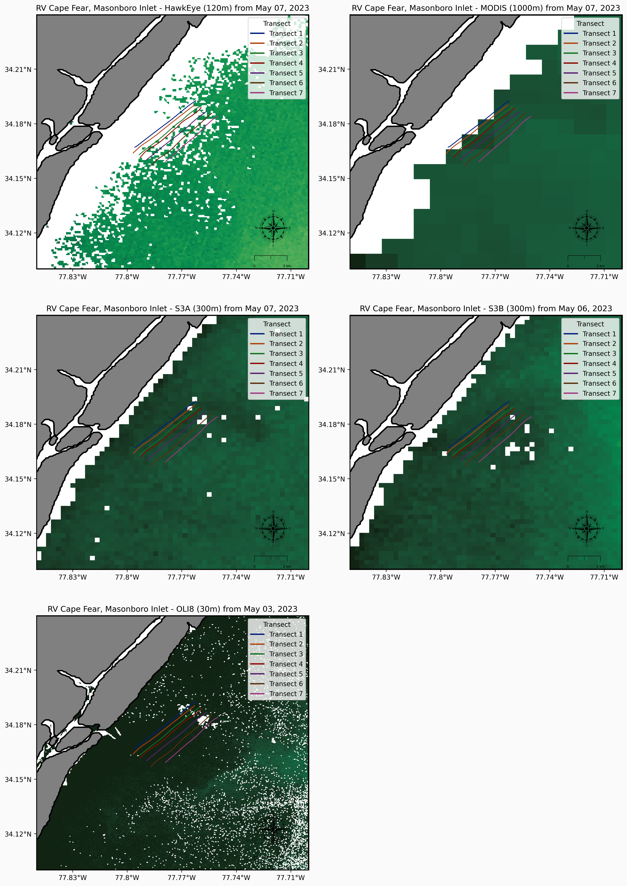
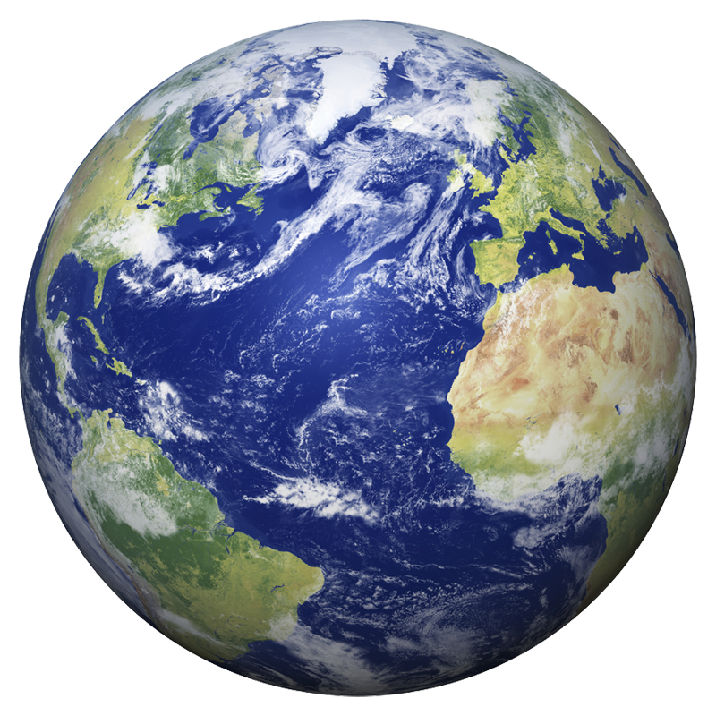
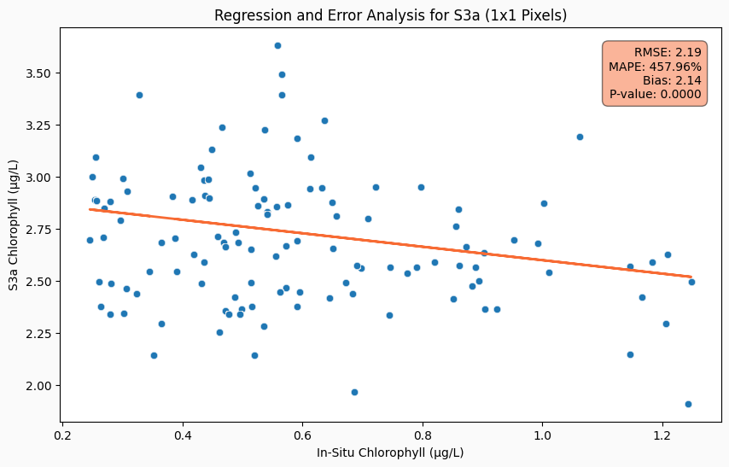
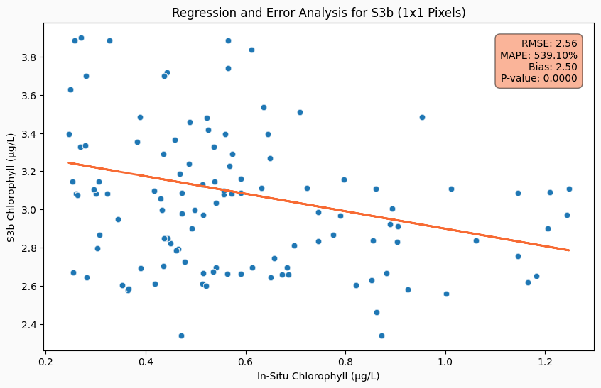
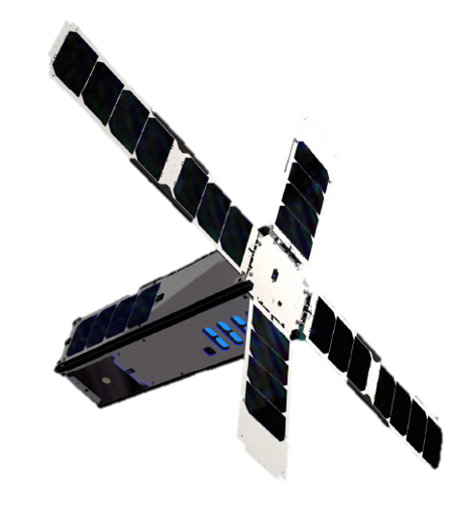
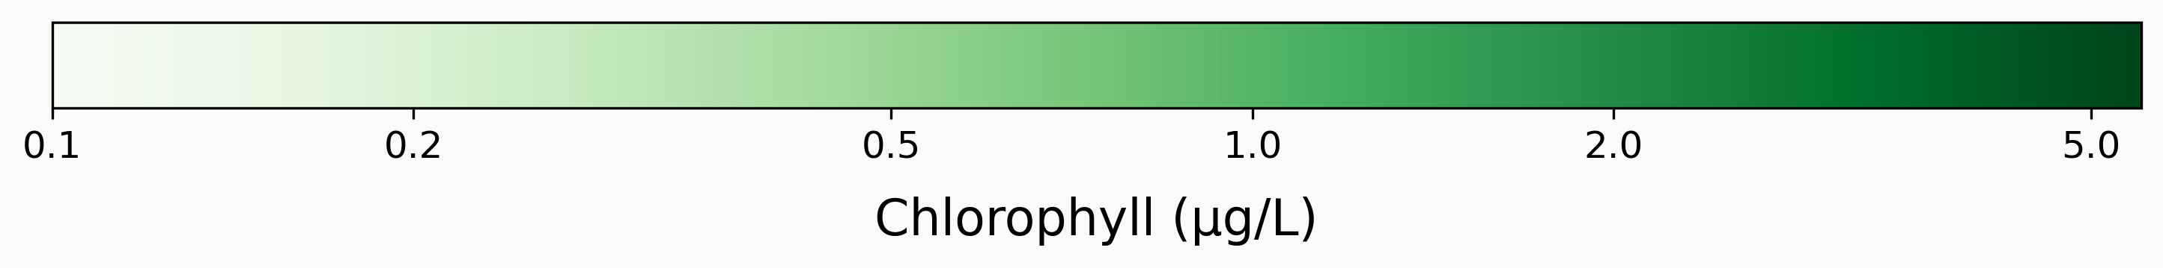



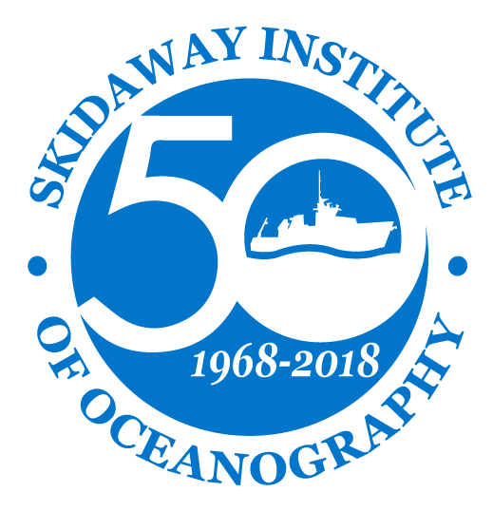
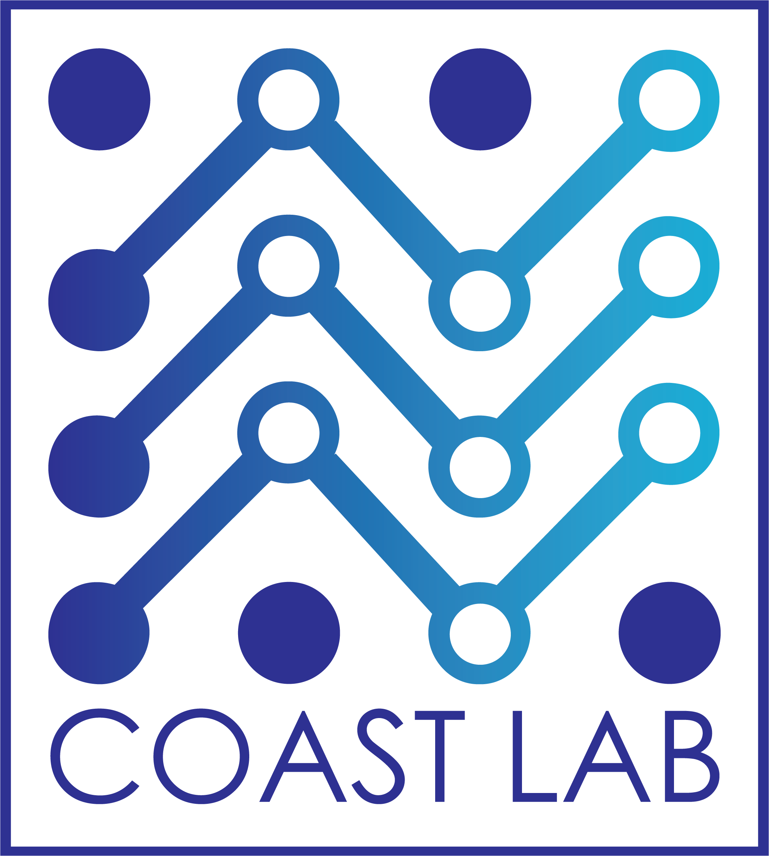



___–––+
HawkEye Ocean Color Imagery
UNCW LOGO
Evaluating Accuracy in Coastal Waters
¹Mitchell D. Torkelson, ¹Dr. Philip Bresnahan, ²Dr. Sara Rivero-Calle, ³Dr. Bob Brewin, ⁴Dr. Bruce Monger, ⁵Dave Wells, ⁶SeaHawk-HawkEye Development and Characterization Team
^{1,5}University of North Carolina-Wilmington, ²UGA Skidaway Institute of Oceanography, ³University of Exeter, ⁴Cornell University
Introduction
Challenges of Remote Sensing in Coastal Zones
This research evaluates the HawkEye satellite sensor's ability to capture ocean color imagery in the Cape Fear River Estuary, highlighting the challenges of studying optically complex waters for marine conservation.
Remote sensing in coastal regions is complex due to the dynamic interplay of light, particulate matter, and water constituents, impacting the accuracy of satellite imagery. The heterogeneity of coastal waters, influenced by factors such as sediment resuspension and terrestrial runoff, poses significant challenges for monitoring and algorithm development. Despite the broad coverage of remote sensing, its accuracy, especially in the coastal context, necessitates continual in-situ validation to understand and manage these ecologically critical zones effectively.
Objectives
Study Site – Masonboro Inlet
The Inlet, a part of North Carolina’s National Estuarine Research Reserve, is crucial for coastal stewardship and marine research. Its jetties influence sediment dynamics and shoreline changes, which are vital for the local ecology. The inlets waters and surrounds habitats support diverse wildlife, including important fish nurseries and protected species like sea turtles and shorebirds. The inlet, remaining naturally dynamic, provides essential insights for coastal management and conservation efforts.
In-Situ Sampling
Sea-Truthing Data Collection: Implement rigorous in-situ sampling in the Cape Fear River Estuary to gather three-dimensional water quality data.
Comparative Analysis: Evaluate the performance of HawkEye's ocean color imagery against traditional satellite sensors and correlate findings with in-situ measurements.
Spatial Variability Investigation: Assess the distribution and concentration variability of chlorophyll within the estuary to better understand the spatial patterns of marine productivity.
Accuracy Assessment: Conduct a comprehensive matchup analysis to determine the accuracy of satellite-derived chlorophyll measurements in capturing the true biogeochemical state of coastal waters.
Utilizing the Acrobat, we conducted seven transects on May 5, 2023, at the mouth of the inlet. Each transect was 4.5 km long, extending up to 4.5 km offshore. The Acrobat goes up and down in the water like a yo-yo, as it is pulled behind the vessel. This approach enables chlorophyll measurements throughout the first 10 meters of the water column.
SW
NE
Sea Sciences Inc: Acrobat
SW
NE
SW
NE
SW
NE
––
NASA Ocean Color
Water Column Variability
The water column in coastal areas like Masonboro Inlet is vertically heterogenous, characterized by varying conditions such as temperature, salinity, and nutrient concentrations at different depths, driven by factors like sunlight penetration, freshwater inflows, and tidal mixing. This stratification is vital for the ecological health of the estuary, influencing the distribution and behavior of marine life.
SW
NE
SW
NE
SW
NE
~300 m
Satellite Data Acquisition
Marinas.com: Masonboro Inlet
Satellite imagery was sourced from multiple platforms including MODIS Aqua, Sentinel 3A and 3B OLCI, Landsat 8 OLI, and SeaHawk HawkEye, focusing on the Lower Cape Fear River Estuary and Masonboro Inlet vicinity. We utilized the Ocean Color Web for data acquisition, processing level-1A TOA sensor readings into level-3 remote sensing reflectance products using SeaDAS software, applying quality control flags to ensure data reliability.
++
Preliminary Matchup Results
The initial regression analysis not only confirms the inherent difficulties in satellite-based chlorophyll estimation but also opens avenues for refining remote sensing methods. The moderate correlation with Hawkeye data suggests that certain sensors may be more adept at capturing coastal chlorophyll signatures, hinting at the potential for sensor-specific calibration. High MAPE and low R² values in other datasets call attention to the need for algorithmic adjustments that account for atmospheric conditions and the heterogeneous nature of coastal waters. These findings lay the groundwork for developing more accurate predictive models that can enhance our understanding of marine ecosystems and assist in the proactive management of coastal resources.
Acknowledgements:
We thank the Gordan and Betty Moore Foundation for funding this project. We thank UNCW’s Center for Marine Science for dock maintenance and data collection support. Thanks to the advisory committee and all who have supported this research. Thanks to the SeaHawk-HawkEye development and characterization team, including John Morrison, Gene Feldman, Alan Holmes, Sean Bailey, Alicia Scott, and Liang Hong.

